Slide 1

California Institute of Regenerative Medicine (CIRM)
Grant Management System (GMS) – QA Consulting Engagement Approach

Slide 2
Discovery Phase Plan/Approach
Acquaint with existing development approach
Capture all development Artefacts
What is the current QA Strategy?
Sample Templates/Documentation
Demonstration of the functional QA Process & Development Process
Process Documentation Review

Slide 3
Capture all Developmental Artefacts
Requirements Gathering
Requirements Validation
Application Design Approach
Architecture
Development/Implementation
What process of development- TDD,BDD,FPA

Slide 4
QA Strategy
Demonstrate how you test an application
Defect Logging
Defect/Issue Tracking
Current defect Lifecycle
Issue Validation and Regression

Slide 5
Application Validation
Demonstrate Key features /workflows
How all above mentioned areas are implemented
Run all the important workflows
Documentation of all Important workflows
Excelencia Team to automate each of the identified workflows
Provide an Estimate of each of the workflows

Slide 6
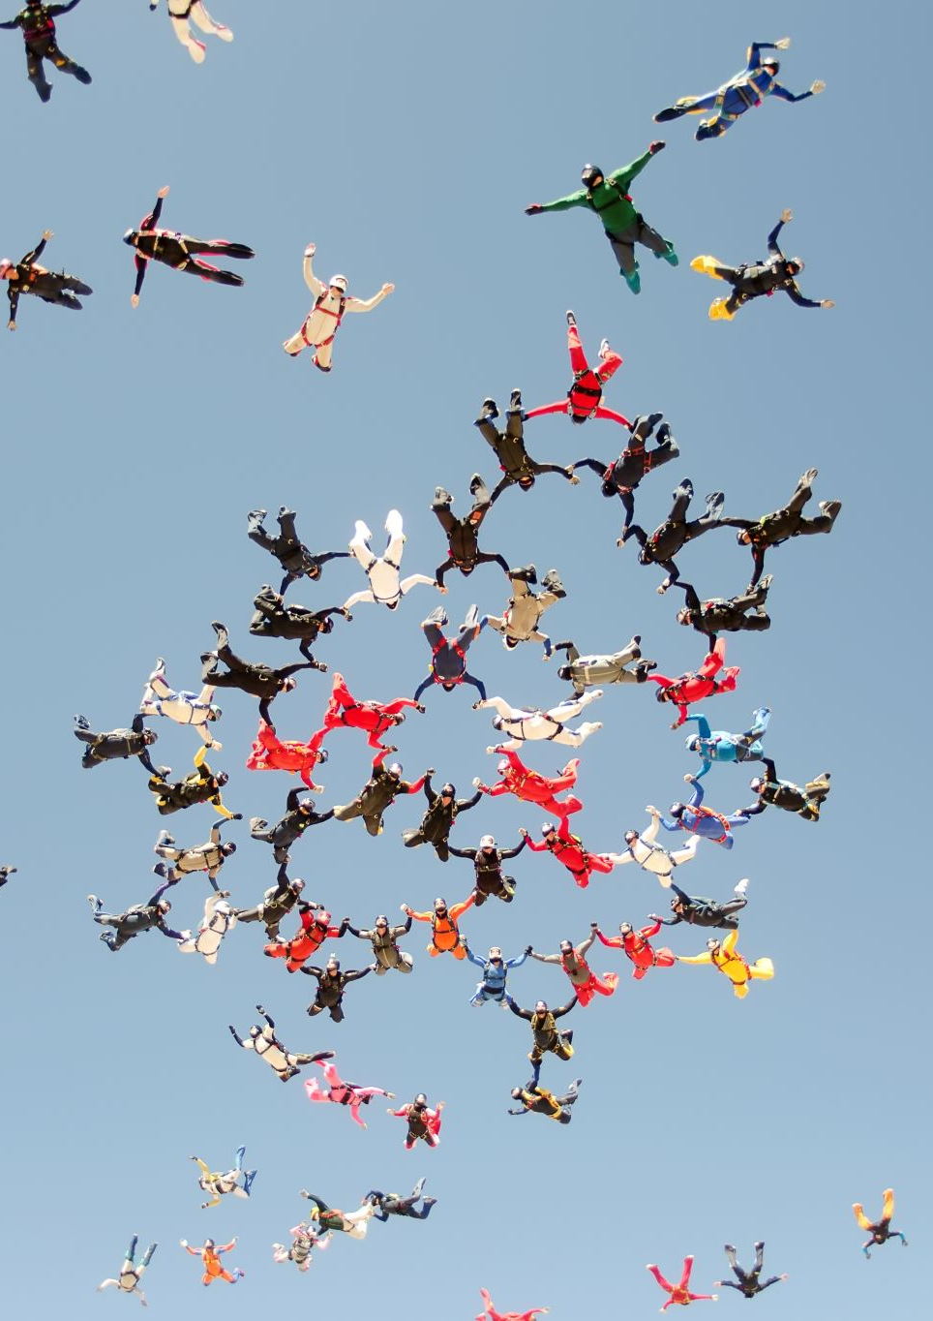
Recommendation Approach
Excelencia Team to identify distinct workflows and capture all details:
Ease of Automation Tool
Effort Required
Timeline
Resources
Dependencies
Risks

Slide 7

Excelencia to handover to CIRM
Issues identified manually
Issues Identified during automation
Logging of Issues
Compare Automation development timeline, effort, tool usage
Recommendation on tool usage

Slide 8
QA Suite Development Strategy
Identify all those features of GMS Application that will be automated
How will the automation for each of features identified be integrated in a test suite?
Test Suite Architecture
Test Suite Design
Primary Test Script
Documentation (If Any)
Identification of Gap in Automation
Submit as Report
Validation of Test automation scripts created
Rollout of Test Scripts

Slide 9
Closure
Packaging of entire testcases script
Release of all project artefacts withheld
Share final Recommendation
Close Project

Slide 10

Notes
This Approach does not factor in the following:
Training
Documentation
Automate the Complete application-only those complex
Performance Validation of the application

Slide 11

Thank You !

